Slide 1
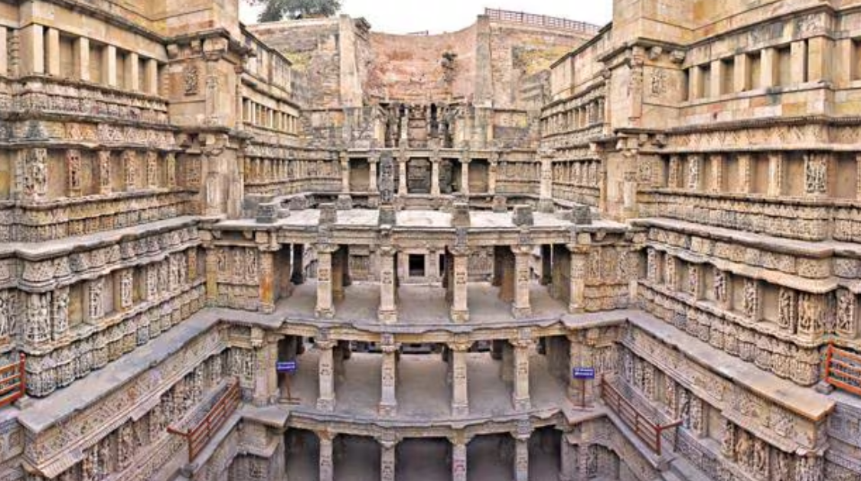
TOURISM
PROJECT
Made by : rudra karia
Class : 12th A
Topic:
Rani ki vav

Slide 2
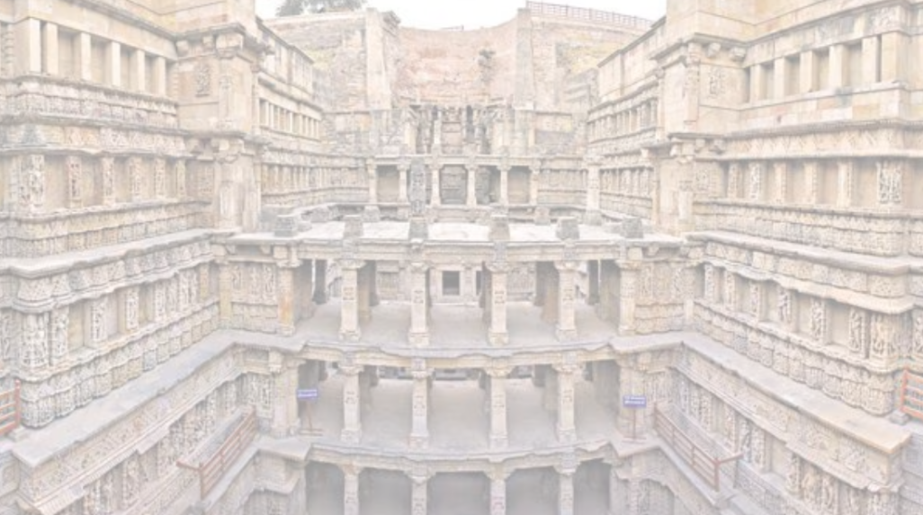
CONTENT
SR no. | Name of topic | Page number
1. | Location of the place | 01
2. | Distance and route from Porbandar | 02
3. | History of the place | 03
4. | Specialties of Rani ki vav | 04
5. | Details of place | 05
6. | Rani ki vav on ₹100 Indian currency note | 06
7. | Facts and picuters of rani ki vav | 07
8. | Conclusion and links for more details | 08

Slide 3
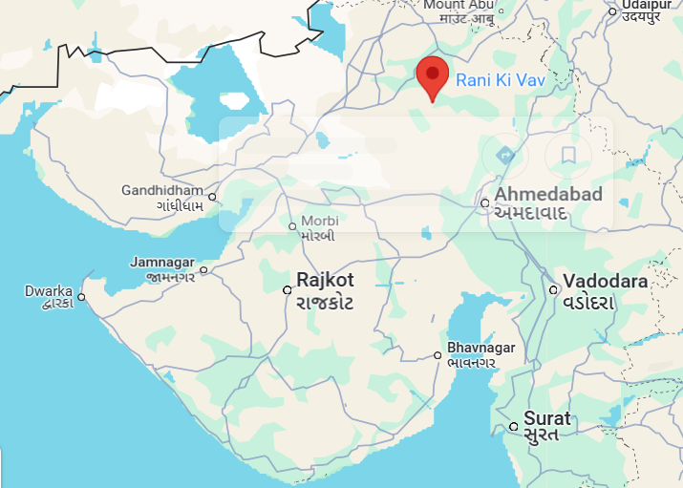
Location Of The Place:-
Rani ki vav (queen’s stepwell) is a beautiful and historically significant stepwell located in Patan, Gujarat, India.
It's not just an architectural marvel, but also a symbol of India’s rich heritage.
1.

Slide 4
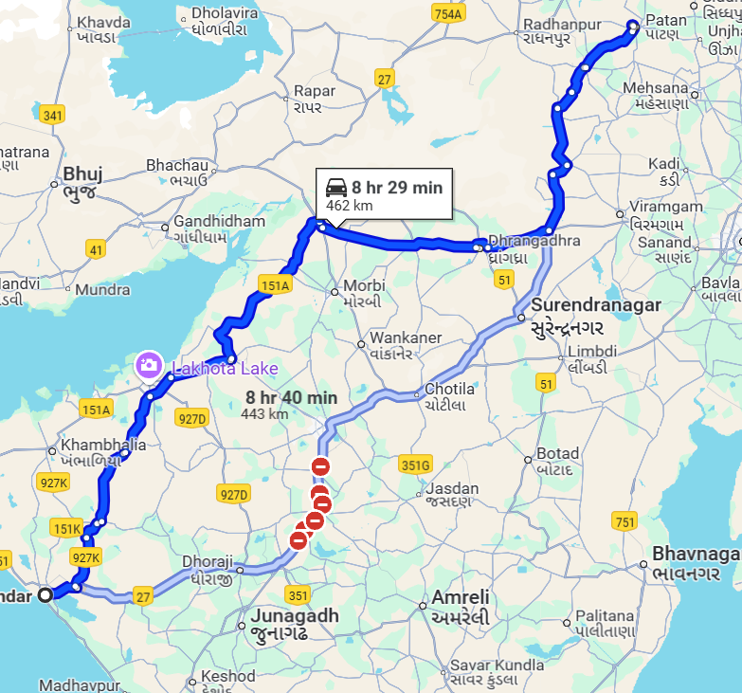
Distance and route from Porbandar:-
Distance from Porbandar is nearly 462.5 km
Time to reach location from Porbandar is 8 -9 hours by road
Route from Porbandar to Patan via NH 27:
Porbandar → Jetpur → Gondal → Rajkot → Morbi → Radhanpur → Patan
2.

Slide 5
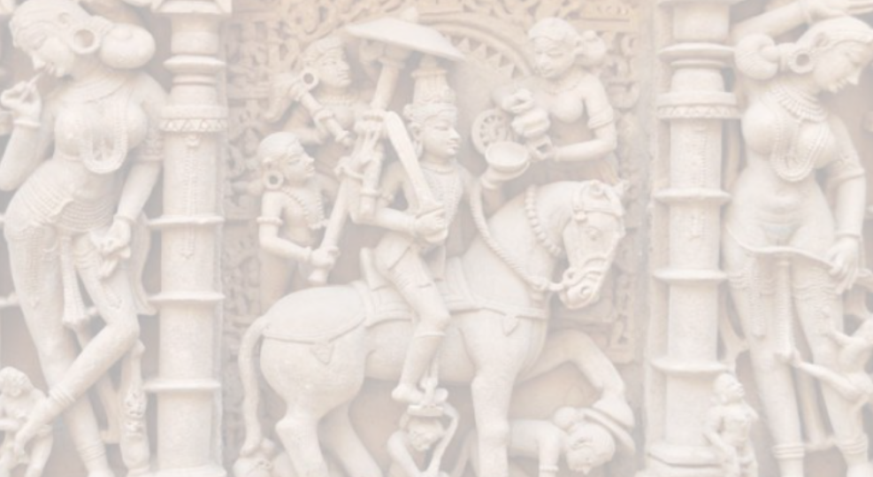
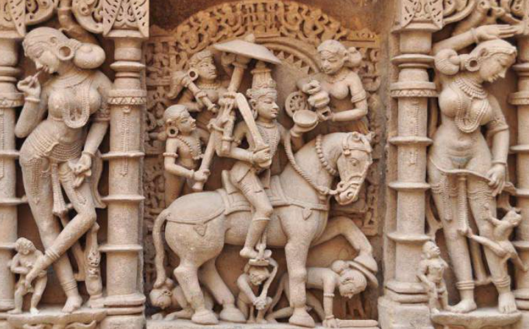
History Of The Place:-
Built in the 11th century by Queen Udayamati, the wife of King Bhimdev- I (Solanki dynasty), in memory of her husband.
It was constructed on the banks of the Saraswati River.
Over time, it was flooded by the river and silted over, remaining hidden for centuries.
In the 1980s, the Archaeological Survey of India (ASI) excavated and restored it to its present glory.
In 2014, it was declared a UNESCO World Heritage Site.
3.

Slide 6
Specialties of Rani ki Vav
Architectural Marvel
It is a stepwell built in the Maru-Gurjara architectural style . Built inverted like a temple, with descending steps leading to the water level . Consists of seven levels of stairs and four pavilions with pillared halls.
Intricate Carvings
Features more than 1,500sculptures carved in sandstone . Depicts Hindu deities ,mythological scenes, apsaras (celestial maidens), and daily life.Notable carvings include Dasha Avtara of Vishnu and Shesh ashayi .”
Water Conservation
SystemStepwells were ingenious water storage systems, especially in arid regions of Gujarat. Rani ki Vav not only served as a source of water but also a cool resting place in summer.
4.

Slide 7
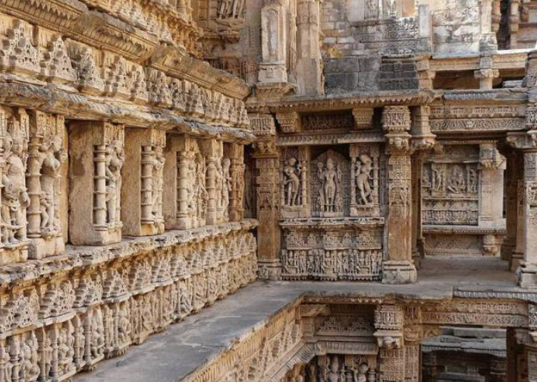
Details of place:
Designed as an inverted temple, it is seven levels deep and is decorated with over 1,500 intricate sculptures of gods, goddesses, apsaras, and mythological scenes.
It is known for its detailed craftsmanship and symmetry.
Apart from being a source of water, it served as a cool retreat and a spiritual center for locals.
The carvings reflect not only religious devotion but also the artistic brilliance of the time.
Rani ki Vav was buried under silt for centuries before being restored by the Archaeological Survey of India and honored as a UNESCO World Heritage Site.
5.

Slide 8
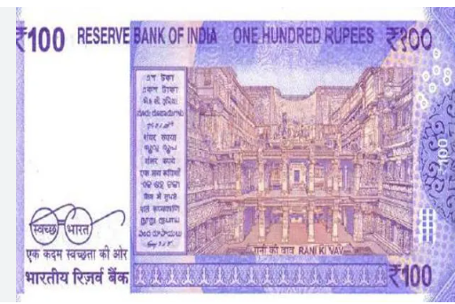
Rani ki Vav on ₹100 Indian Currency Note:-
Rani ki Vav is proudly featured on the reverse side of the ₹100 Indian banknote, issued by the Reserve Bank of India (RBI) in 2018.
It was chosen to highlight India's rich architectural and cultural heritage.
This inclusion brought national and global attention to the stepwell's intricate beauty.
6.

Slide 9
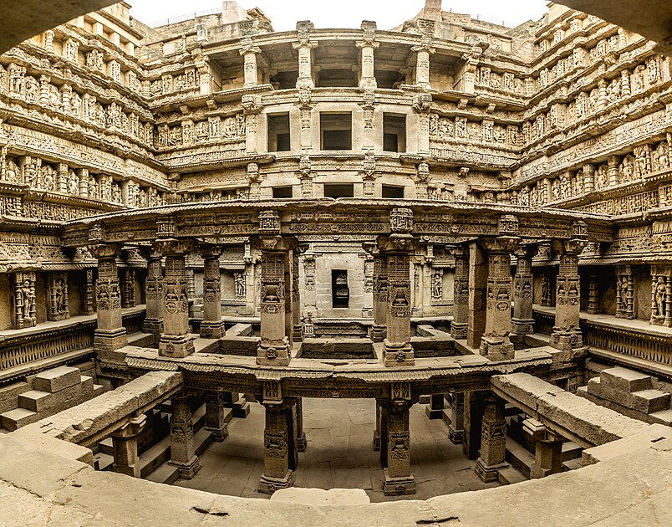
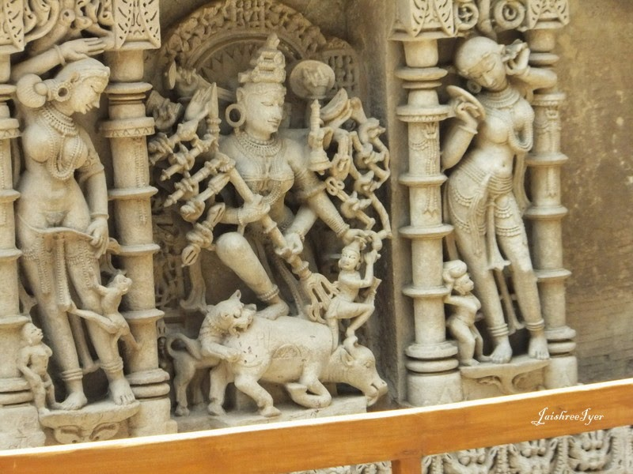
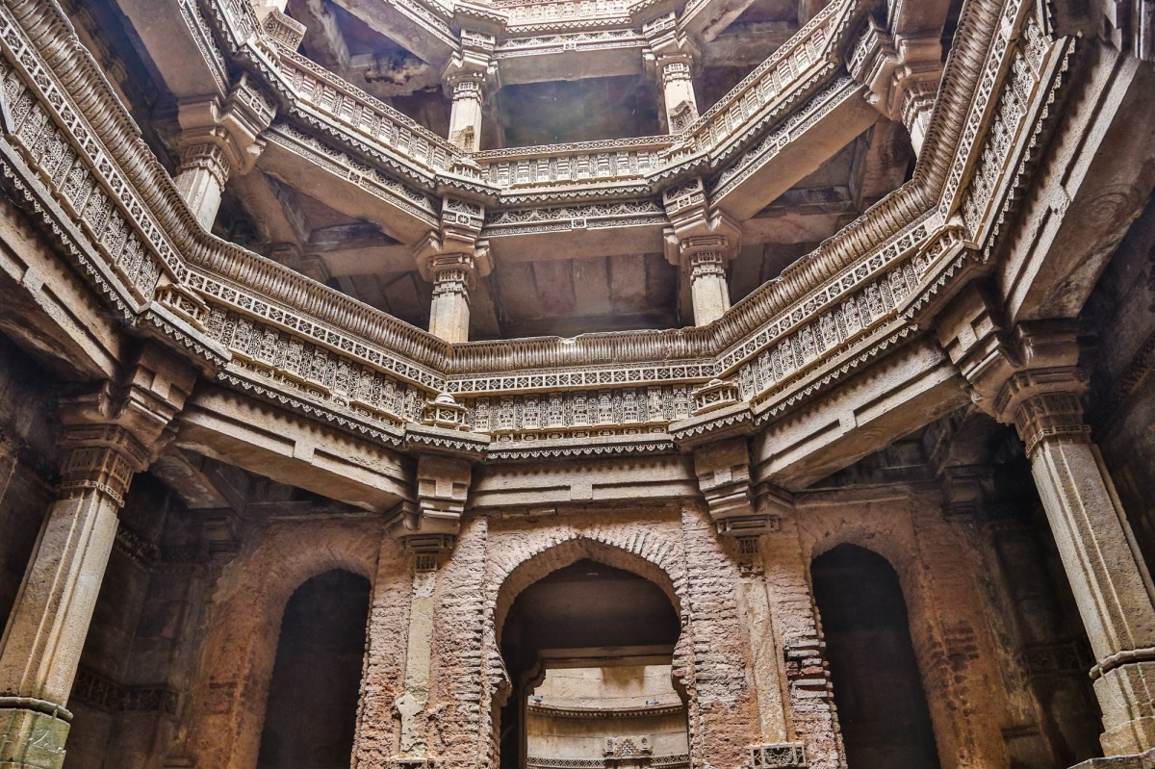
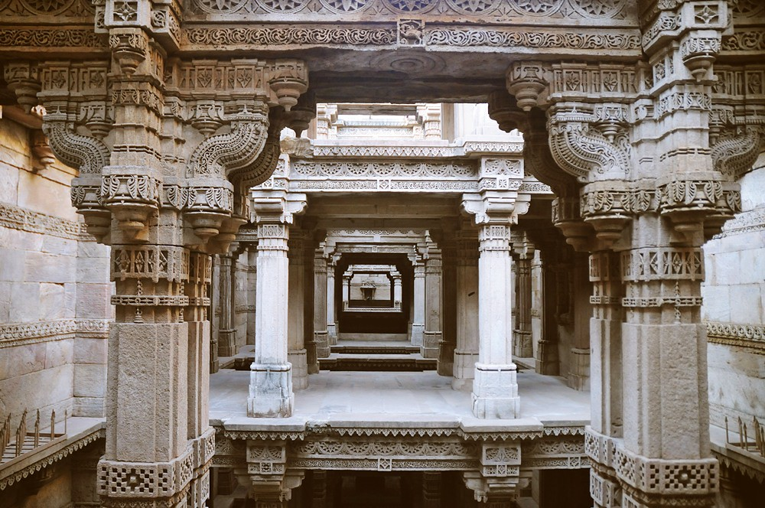
Facts and picuters of rani ki vav:-
Pictures of rani ki vav:-
Some interesting facts:
Built without cement or metal .
Naturally cool.
Over 1,500 sculptures.
Perfect symmetry.
7.

Slide 10
Conclusion :-
Rani ki Vav is a beautifully carved stepwell built in the 11th century by Queen Udayamati . It was designed like an inverted temple and has over 1,500 detailed sculptures.
The stepwell served both as a water source and a cool resting place. It shows the great architecture and art of ancient India. Today, it is a UNESCO World Heritage Site and is also featured on the ₹100 note.
Links for more information:-
1.UNESCO World Heritage – Rani ki Vav
2.
3. Gujarat Tourism Official Page
4. Wikipedia – Rani ki Vav
Archaeological Survey of India (ASI) – Rani ki Vav
8.

Slide 11
THANKYOU

